Slide 1
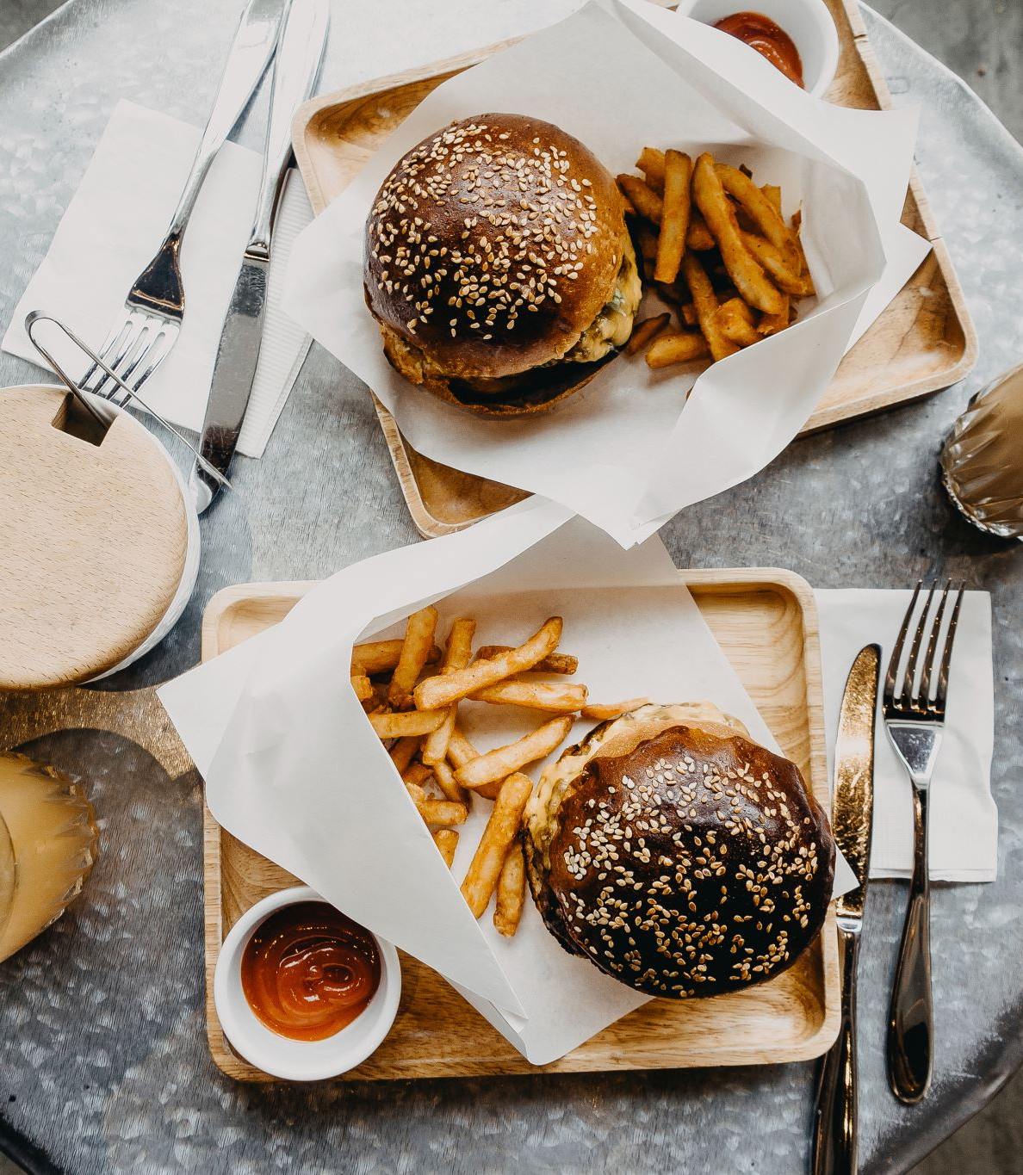
Track What You Eat
Prasanna
Yamini
Mounisri

Slide 2
Replacing t traceable with 0 in all columns like calories, fat etc. We found out that there are no null values.
Data Preprocessing and cleaning

Slide 3
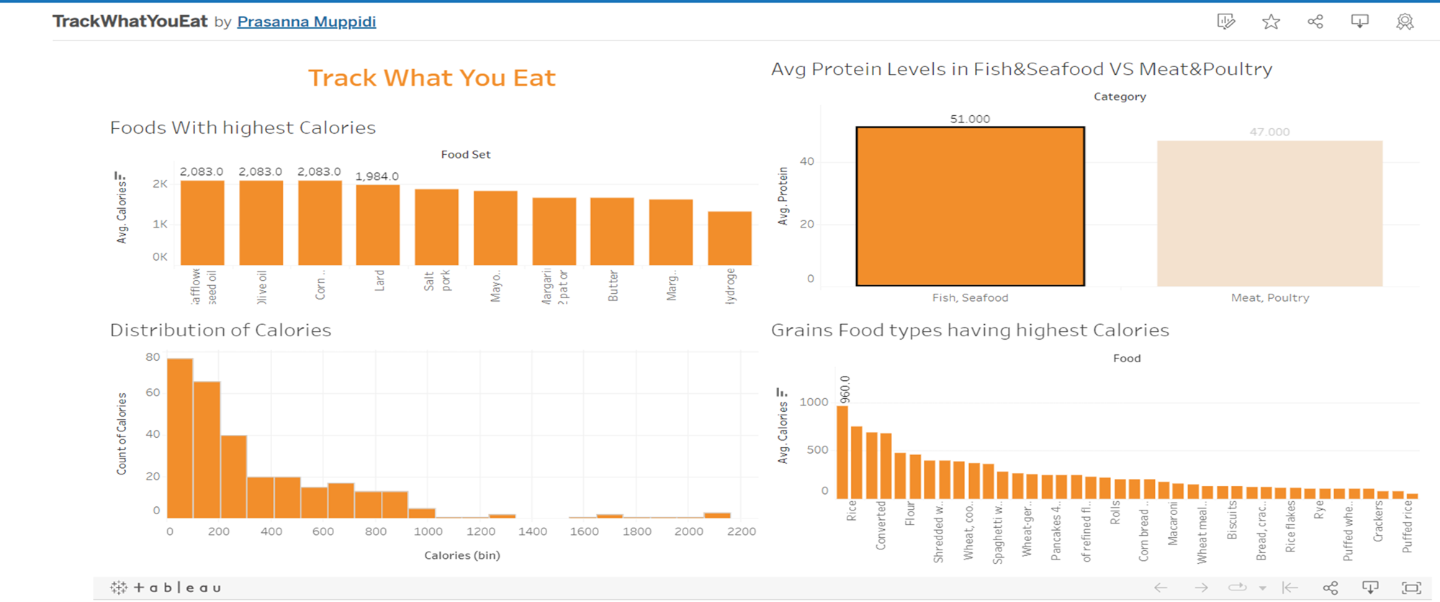
Tableau Dashboard Click the link to know more: Track What You Eat

Slide 4
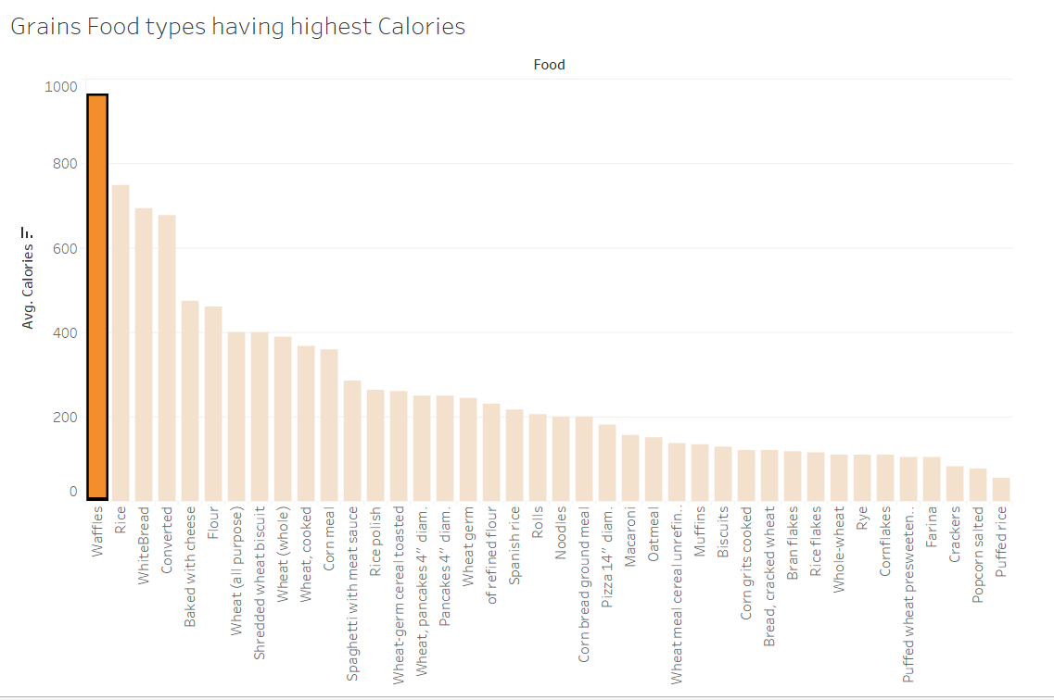
In Grains, Waffles has the highest calories(960 calories)

Slide 5
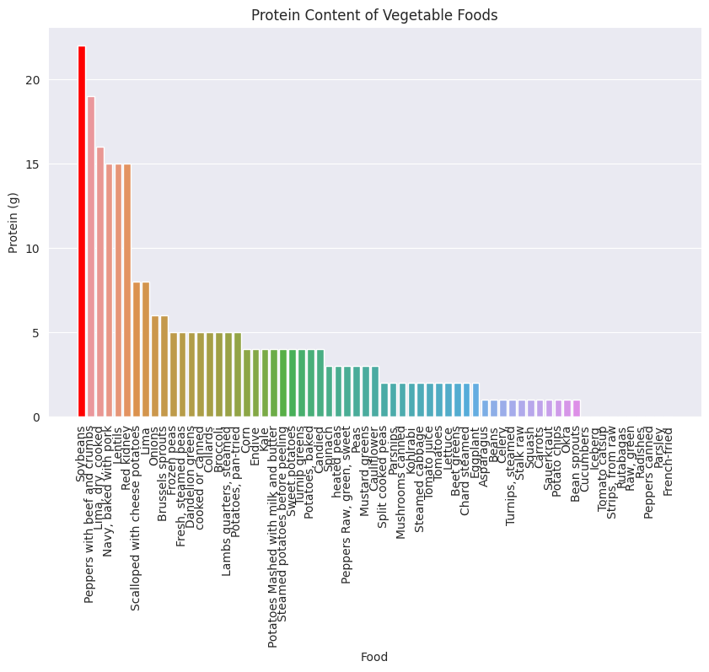
Question3:
In Vegetable Foods, Soybeans has the highest protein content

Slide 6
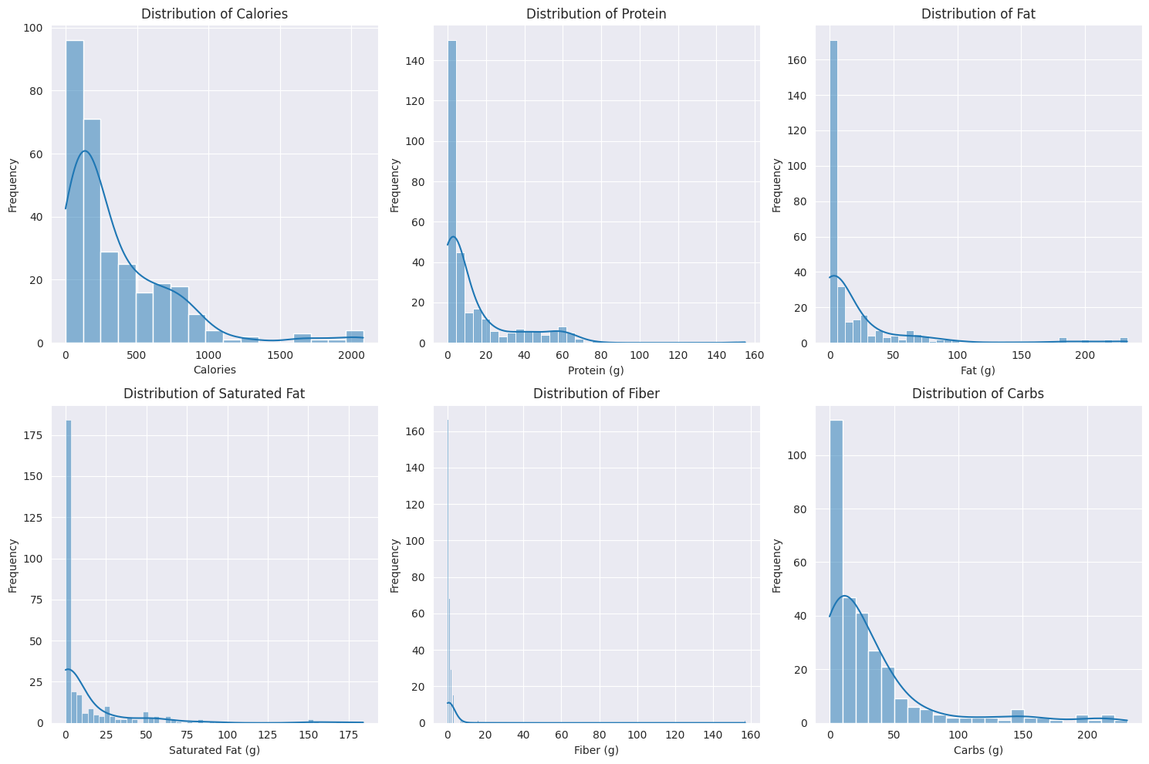
Question 1:
We can see in calories, carbs, fat, saturated fat are right skewed

Slide 7
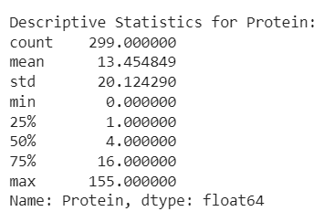
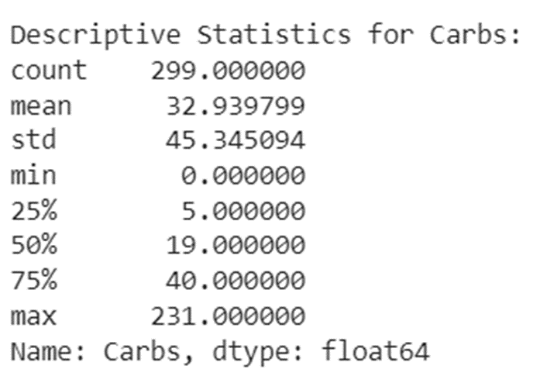
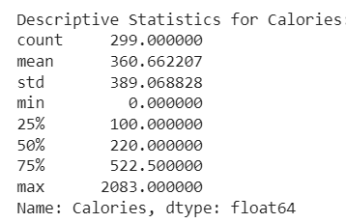
Calories: The dataset's mean caloric intake ranges from 0 to 2083, or roughly 360 calories on average. The overall distribution of calories is slightly tilted to the right, with a greater percentage of lower calorie items, according to the median (50th percentile), which is 220. A great deal of foods fall within the 25th and 75th percentiles, which are between 100 and 522.5, respectively.
Protein: Considering a wide range from 0 to 155 grams, the dataset's mean protein content is roughly 13.45 grams. The distribution of protein is similarly somewhat tilted to the right, with a higher percentage of lower protein foods, according to the median (50th percentile) of 4 grams. Given that the 25th and 75th percentiles of protein content are 1 and 16, respectively, the majority of foods fall within this range.
Carbs: The dataset's mean carbohydrate content ranges from 0 to 231 grams, with a mean of about 32.94 grams. The distribution of carbohydrates is slightly tilted to the right, with a greater proportion of lower carbohydrate items, as indicated by the median (50th percentile) of 19 grams. The average diet contains between 5 and 40 grams of carbohydrates, which corresponds to the 25th and 75th percentiles.

Slide 8
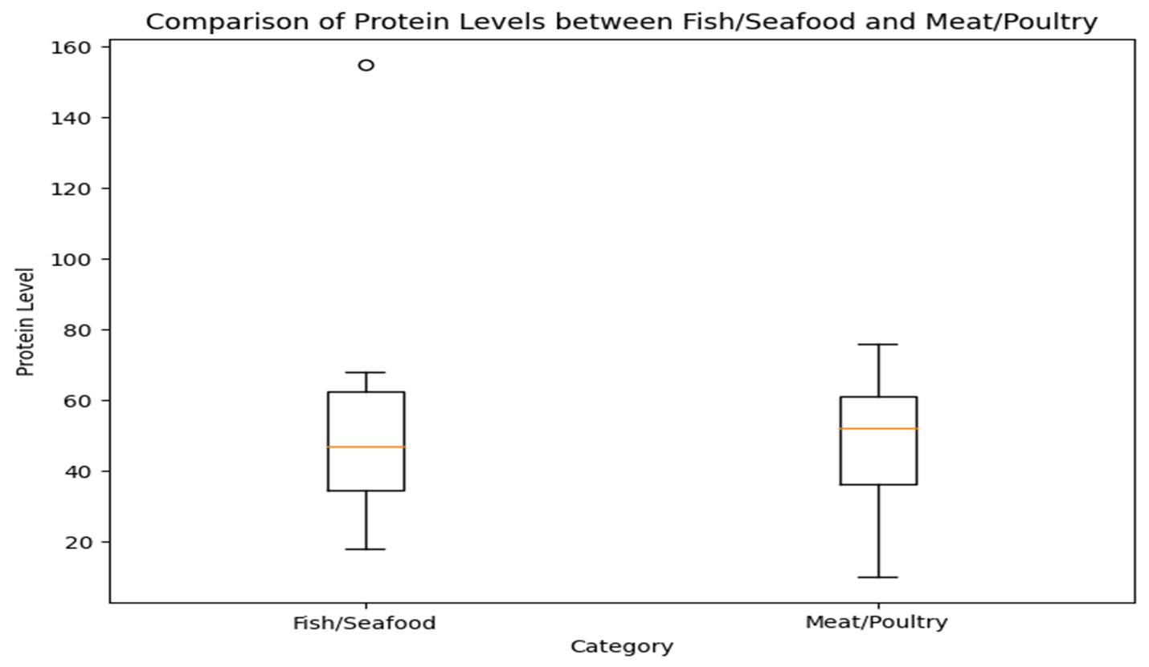
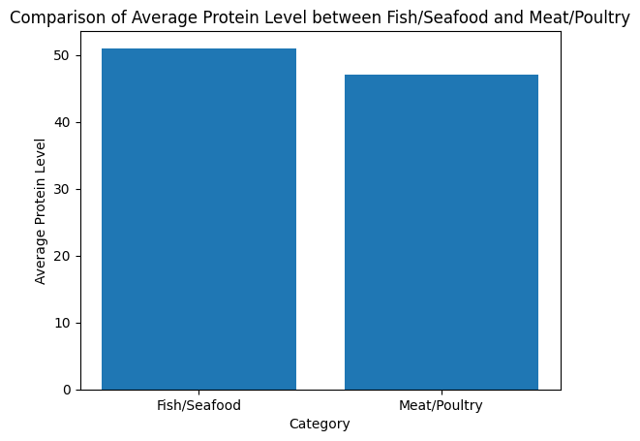
Question2:
We can see median protein level is more in meat compared to fish and meat is more left skewed whereas fish looks lightly right skewed
Fish/seafood(51) has more avg calories than Meat/Poultry(47)

Slide 9
Are avg protein level in fish, poultry statically same or different
Null Hypothesis: There is no difference in avg protein labels in Fish/SeaFood and Meat?poultry
Alternate Hypothesis:There is difference in avg protein labels in Fish/SeaFood and Meat?poultry
As p is not less than 0.05, we fail to reject null hyphothesis, so we can conclude that there is no statistically significant difference in protein levels between Fish/Seafood and Meat/Poultry categories (p-value >= 0.05)

Slide 10
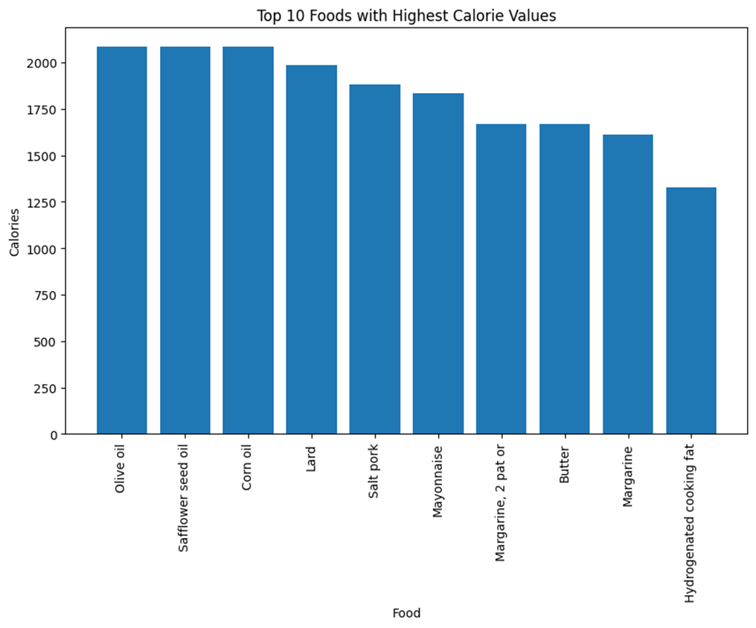
Question3:
Here are the top 10 foods with highest Calories: Olive oil, Safflower Seed Oil and corn oil are the top highest calorie foods with almost same calories, Margarine, Butter has almost same calories

Slide 11
Thankyou!

